Slide 1
5.1 Randomness
The Language of Probability
Thinking about Randomness
The Uses of Probability

Slide 2
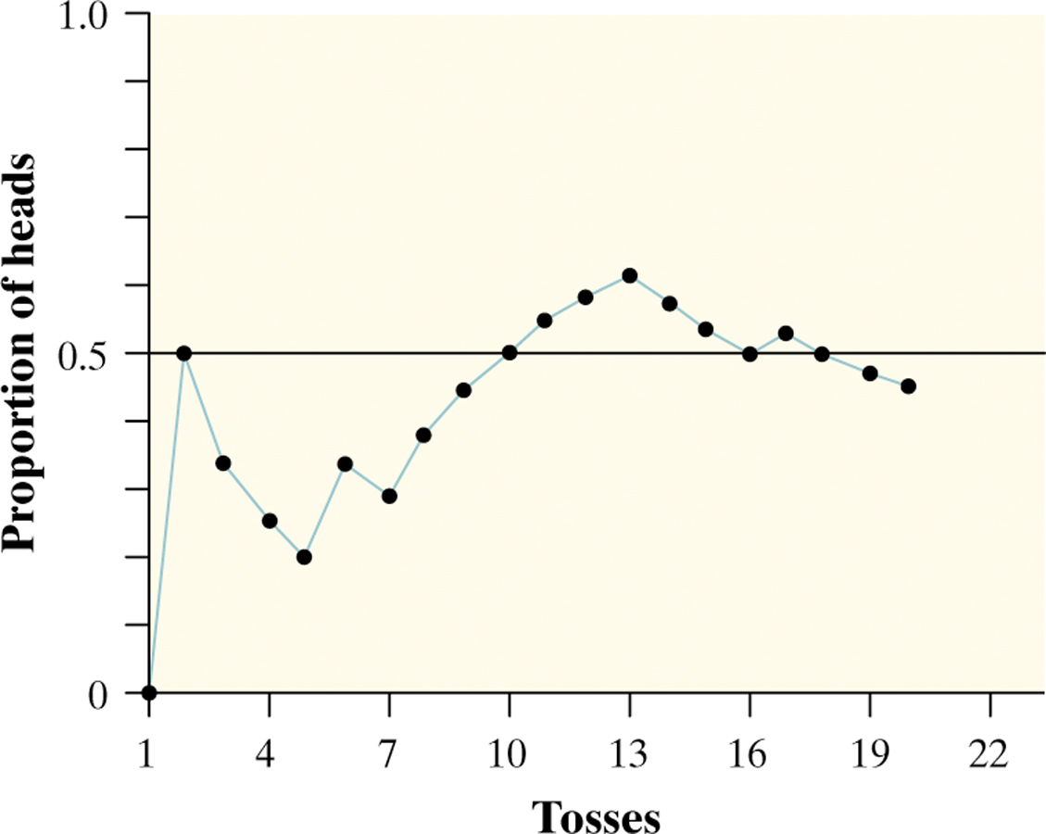

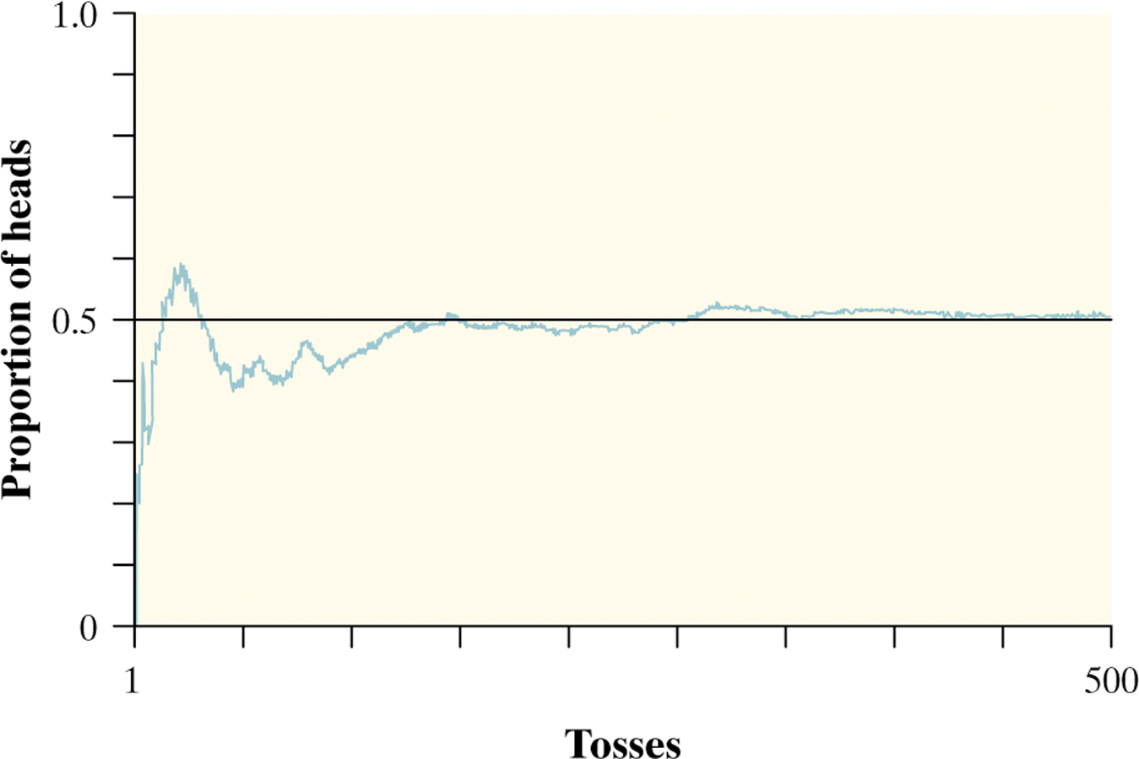
The Language of Probability
Chance behavior is unpredictable in the short run, but has a regular and predictable pattern in the long run.
We call a phenomenon random if individual outcomes are uncertain but there is nonetheless a regular distribution of outcomes in a large number of repetitions.
The probability of any outcome of a chance process is the proportion of times the outcome would occur in a very long series of repetitions – relative frequency!

Slide 3
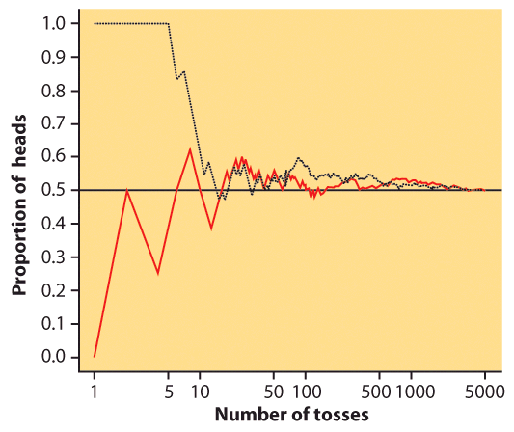
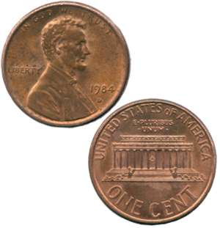
Thinking about Randomness
The result of any single coin toss is random. But the result over many tosses is predictable, as long as the trials are independent (i.e., the outcome of a new coin flip is not influenced by the result of the previous flip).
The probability of heads is 0.5 = the proportion of times you get heads in many repeated trials.
First series of tosses
Second series

Slide 4
5.2 Probability Models
Sample Spaces
Probability Rules
Assigning Probabilities
Independence and the Multiplication Rule

Slide 5
Probability Models
Descriptions of chance behavior contain two parts: a list of possible outcomes and a probability for each outcome.
The sample space S of a chance process is the set of all possible outcomes.
An event is an outcome or a set of outcomes of a random phenomenon. That is, an event is a subset of the sample space.
A probability model is a description of some chance process that consists of two parts: a sample space S and a probability for each outcome.

Slide 6
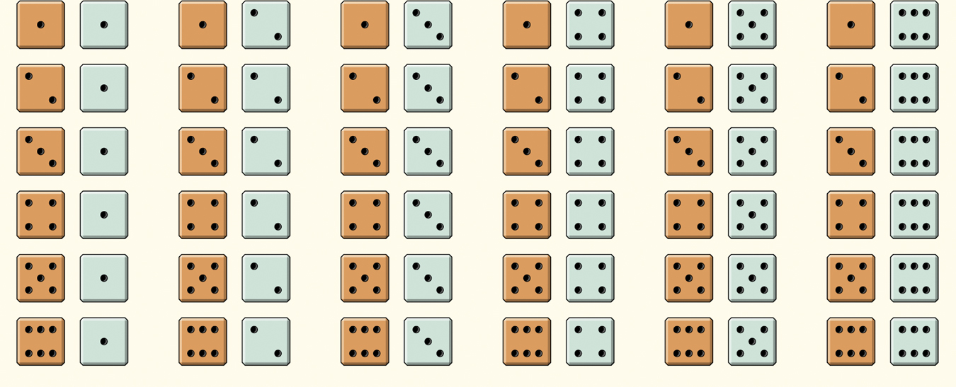
Probability Models
Example: Give a probability model for the chance process of rolling two fair, six-sided dice―one that’s red and one that’s green.
Sample Space
36 Outcomes
Since the dice are fair, each outcome is equally likely.
Each outcome has probability 1/36.

Slide 7
Probability Rules
Any probability is a number between 0 and 1.
All possible outcomes taken together must sum to probability 1.
If two events have no outcomes in common, the probability that one or the other occurs is the sum of their individual probabilities.
The probability that an event does not occur is 1 minus the probability that the event does occur.
Rule 1. The probability P(A) of any event A satisfies 0 ≤ P(A) ≤ 1.
Rule 2. If S is the sample space in a probability model, then P(S) = 1.
Rule 3. If A and B are disjoint, P(A or B) = P(A) + P(B).
This is the addition rule for disjoint events.
Rule 4: The complement of any event A is the event that A does not occur, written A^{C}. P(A^{C}) = 1 – P(A).

Slide 8
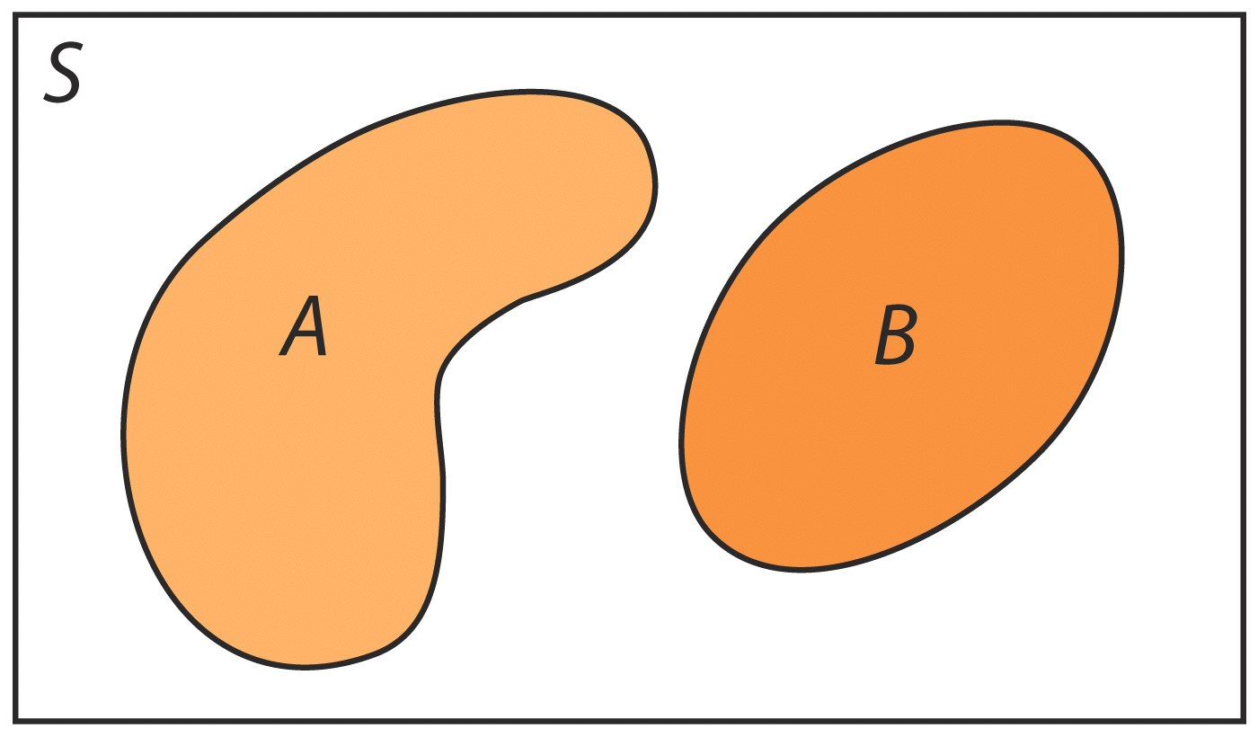
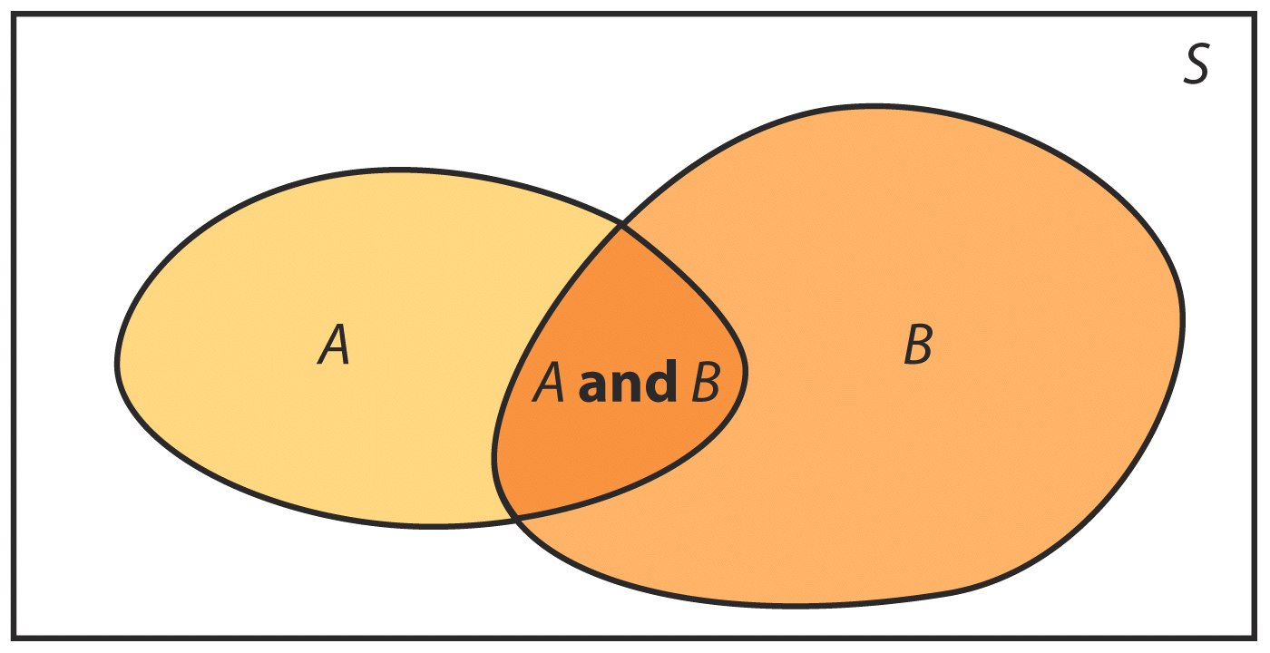
Venn Diagrams
Sometimes, it is helpful to draw a picture to display relations among several events. A picture that shows the sample space S as a rectangular area and events as areas within S is called a Venn diagram.
Two events that are not disjoint, and the event {A and B} consisting of the outcomes they have in common:
Two disjoint events:

Slide 9
Finite Probability Models
One way to assign probabilities to events is to assign a probability to every individual outcome, then add these probabilities to find the probability of any event. This idea works well when there are only a finite (fixed and limited) number of outcomes.
A probability model with a finite sample space is called finite.
To assign probabilities in a finite model, list the probabilities of all the individual outcomes. These probabilities must be numbers between 0 and 1 that add up to exactly 1. The probability of any event is the sum of the probabilities of the outcomes making up the event.

Slide 10
Multiplication Rule for
Independent Events
If two events A and B do not influence each other, and if knowledge about one does not change the probability of the other, the events are said to be independent of each other.
Multiplication Rule for Independent Events
Two events A and B are independent if knowing that one occurs does not change the probability that the other occurs. If A and B are independent:
P(A and B) = P(A) × P(B)

Slide 11
HW: Read section 5.1 and do the following:
#5.1 simulate the toss of a coin 20 times using Table B
Simulate “toss a fair coin until the first H appears”
using Table B – repeat this simulation 20 times and
email the results to me by Friday at 6:00 am in
a .csv or .jmp or .xls file ( or in the email one line at a time )

